Slide 1
Week 1
Introduction to Convolutional Neural Networks

Slide 2
Topics you have covered in week 1 videos
Image data structures and types
Convolution of Filters/kernels on Images
Convolutional neural networks vs Fully connected networks
Convolutional layers
Average and Max Pooling layers
Forward prop and Backprop in CNNs
Implementation of CNNs in Keras

Slide 3
Session agenda
Basics of Image handling in python
Understanding filtering
Understanding CNNs
Case study
Questions

Slide 4
Image basics

Slide 5
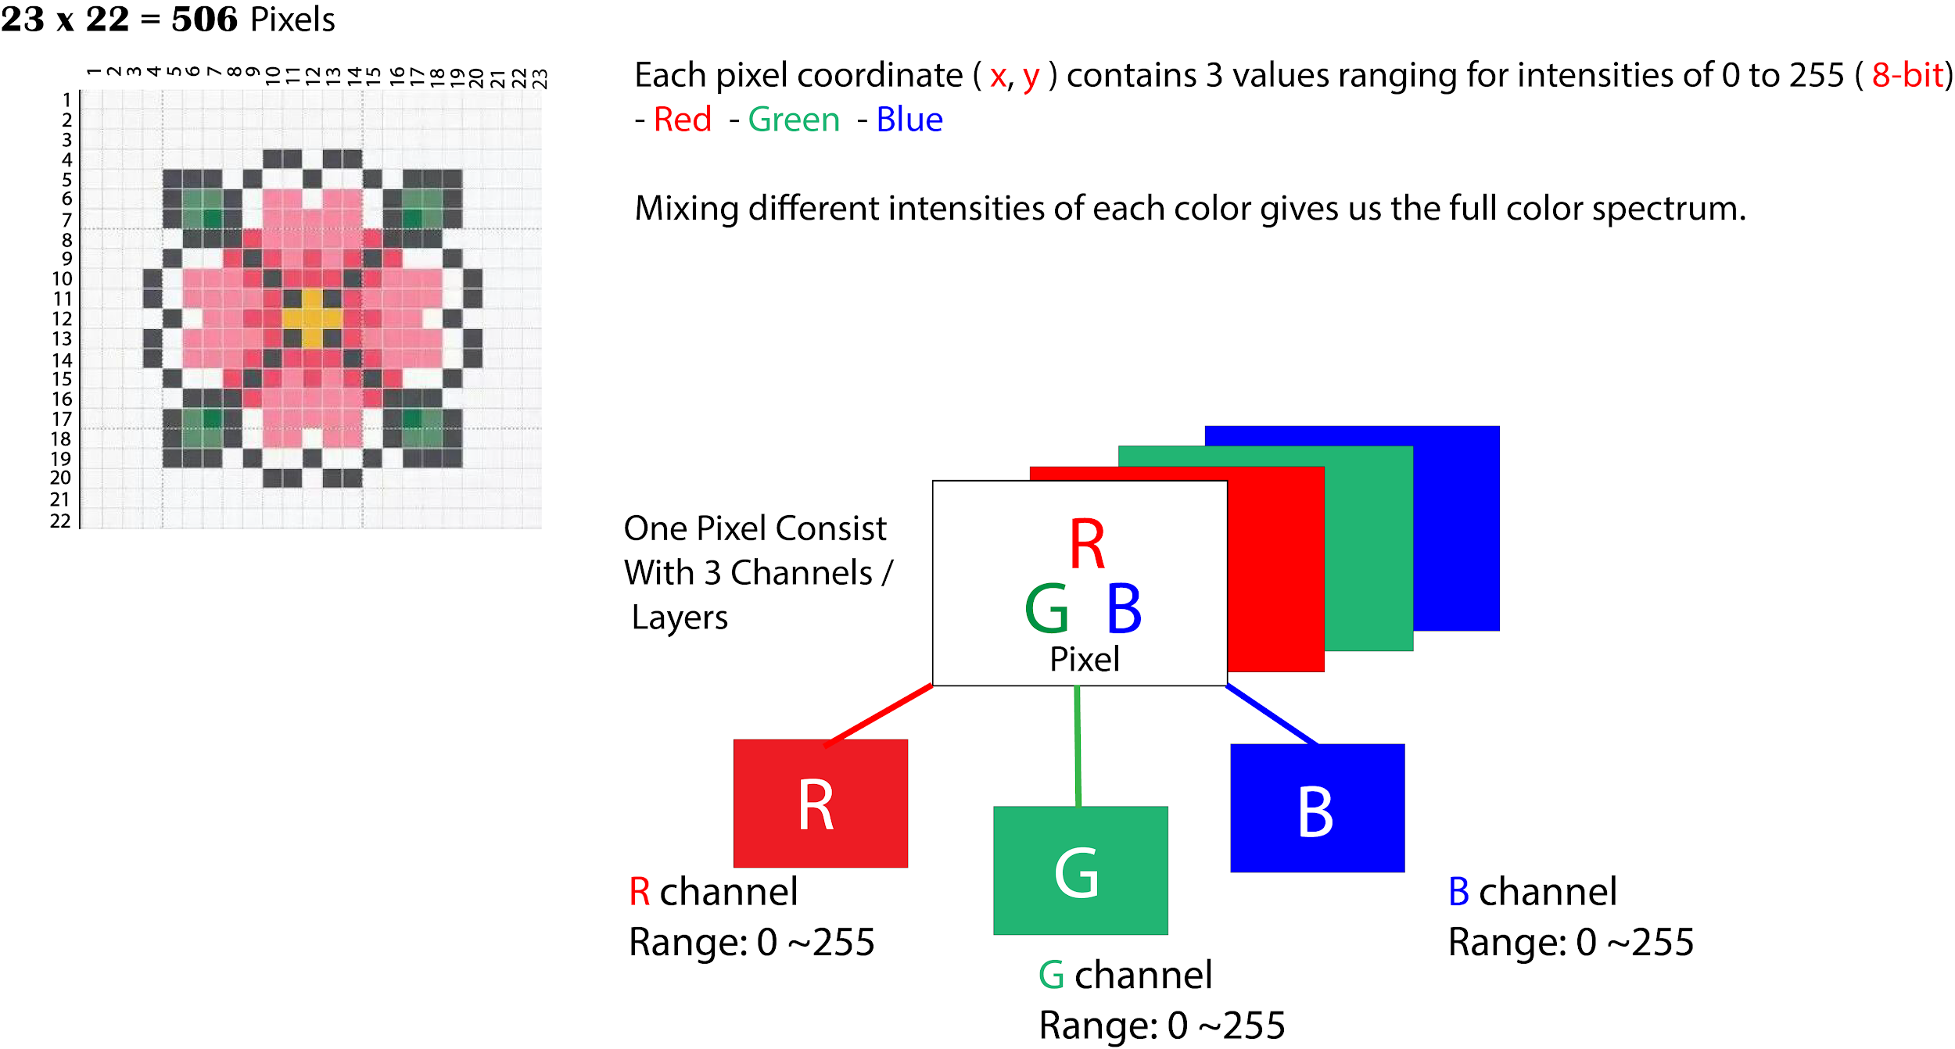
Digital Images
Digital Images are 2D or 3D matrices depending upon if they are greyscale or colour images. An entire image is discretized into small units called pixels. Each pixel is identified by it’s row and column number. Each pixel in a grayscale or black and white image has a single value (Range 0~255) denoting the intensity of the image at that pixel location. Each pixel in a colour image has respectively 3 values(Range 0~255) denoting the intensities of Red, Blue and Green channels.
The size of the image is generally denoted by the number of rows and columns.
Image and text source: dzone

Slide 6
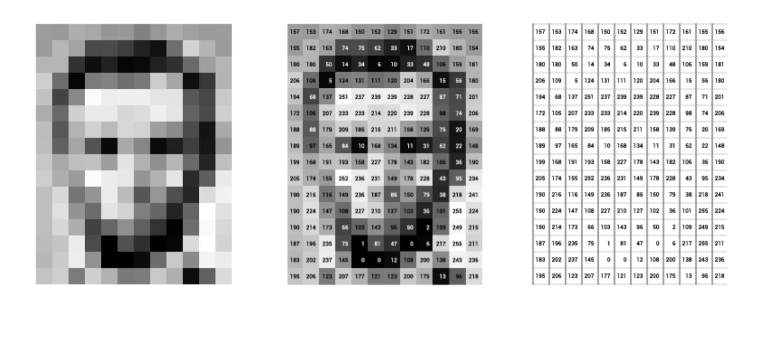
Digital Images
Image and text source: dzone
Notes:
Digital images are discretized into small units called pixels and they form a matrix with values between 0-255. Each value denotes the intensity of the image at the pixel

Slide 7
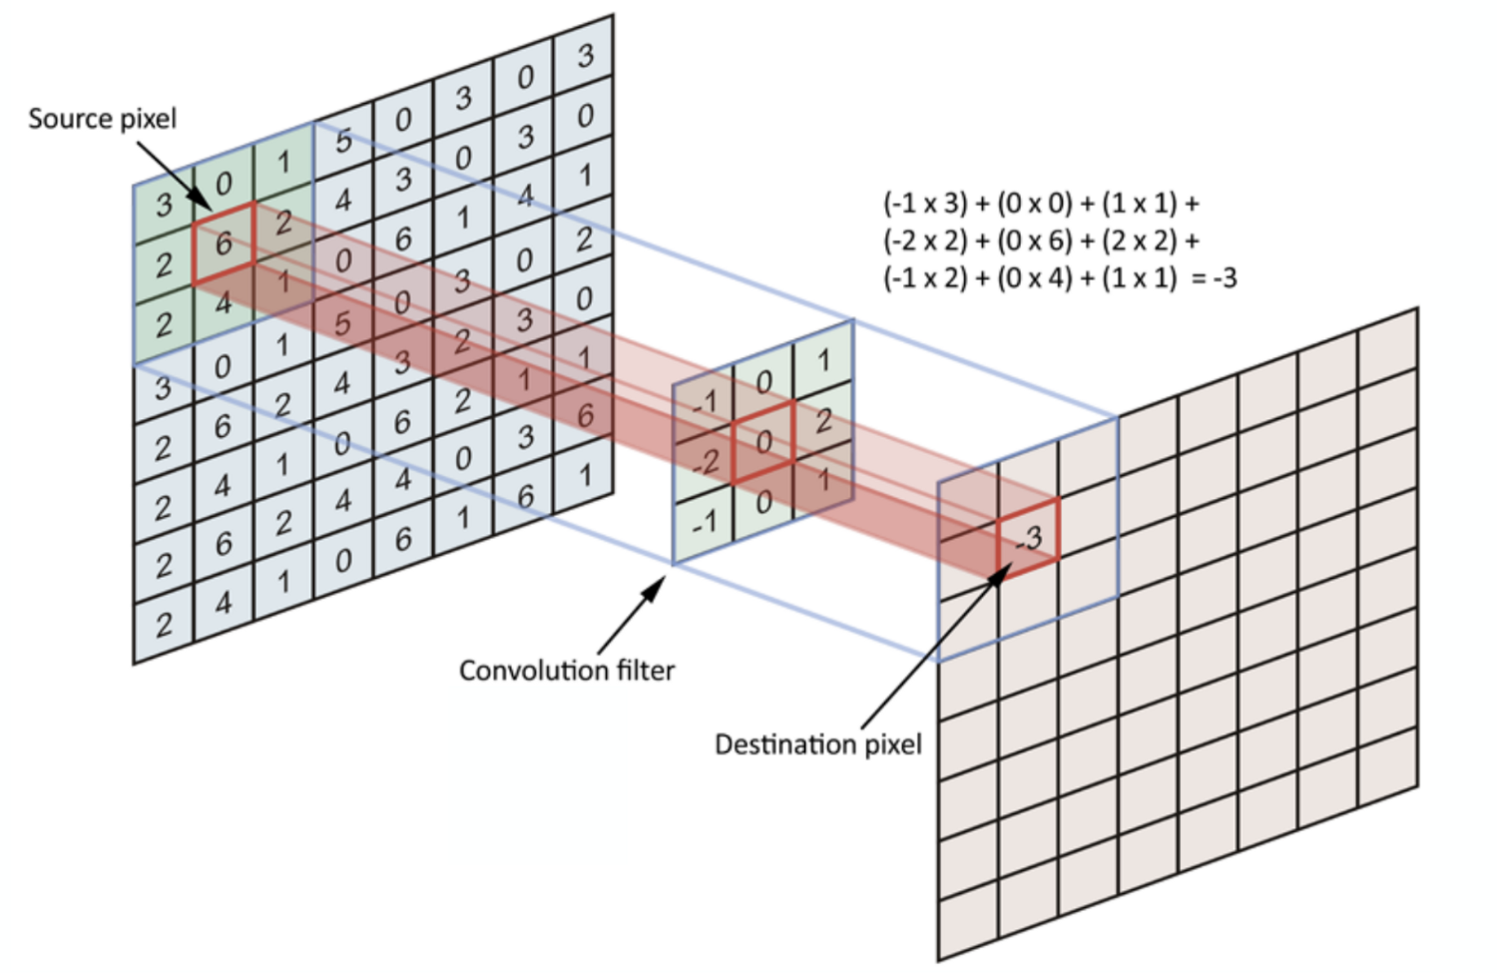
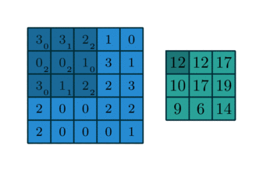
Image filtering
Image source: towardsdatascience
Notes:
This is correlation of a kernel with an image. The kernel is moved along X and Y directions by fixed step size called stride. If the stride is 2, the kernel moves 2 pixels in both X and Y direction after each iteration. The kernel starts at the top left of the image and superimposed like shown in the left image. The corresponding values are multiplied and summed to get the respective value on the output. Then kernel is moved based on the stride like shown in the right image, and the same process is continued.

Slide 8
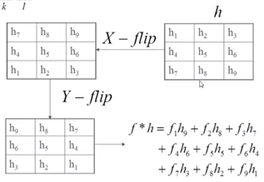
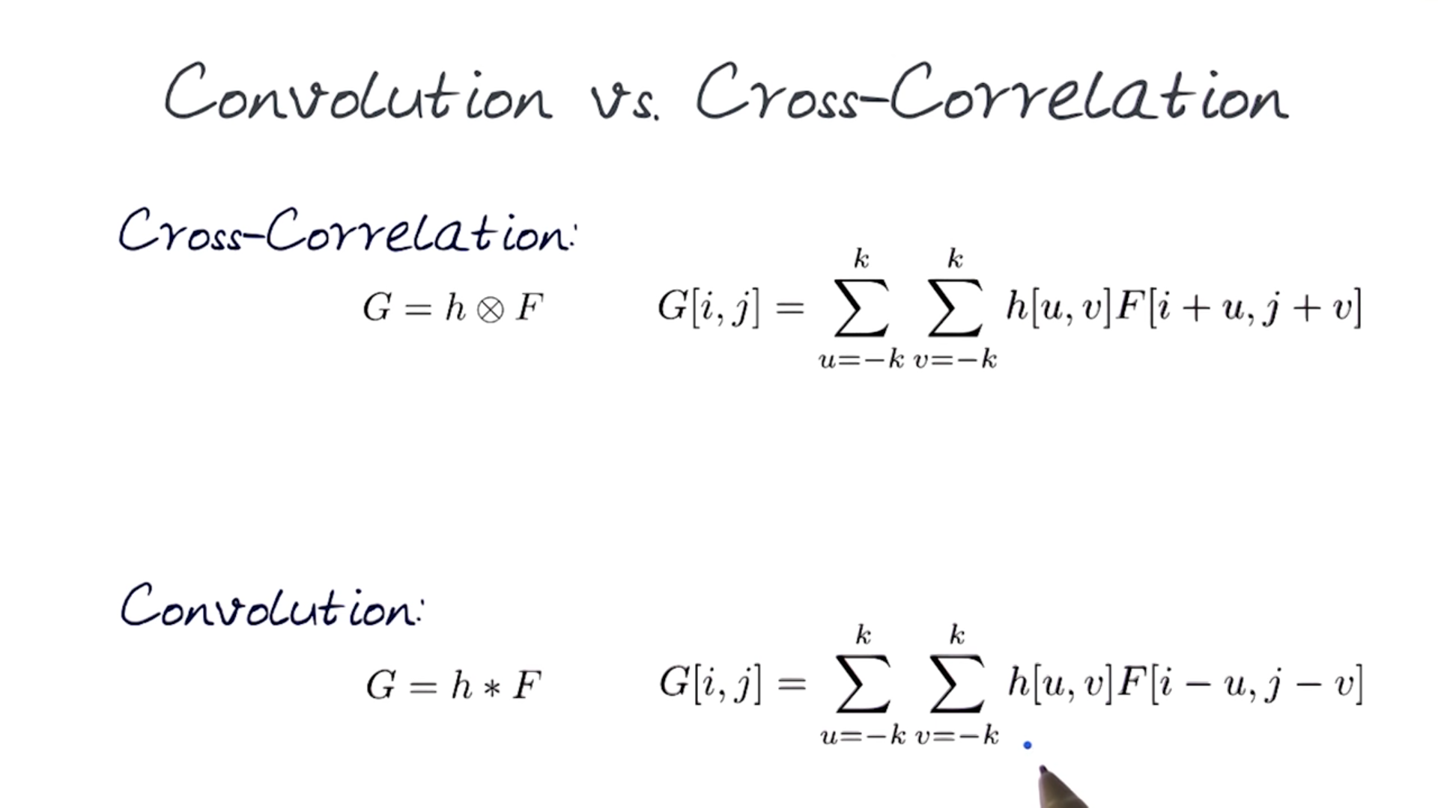
Convolution vs Correlation
Convolution:
Correlation:
Convolution is basically flipping the kernel via X-axis and Y-axis and then performing a correlation with the resultant kernel
Notes:
Convolution is basically flipping the kernel via X-axis and Y-axis and then performing a correlation with the resultant kernel. In CNNs even though we perform correlation operation, we call it the convolutional neural networks as all the values of the filter/kernel are unknown variables. So even if the kernel is flipped or not flipped it’s not going to make a difference.

Slide 9
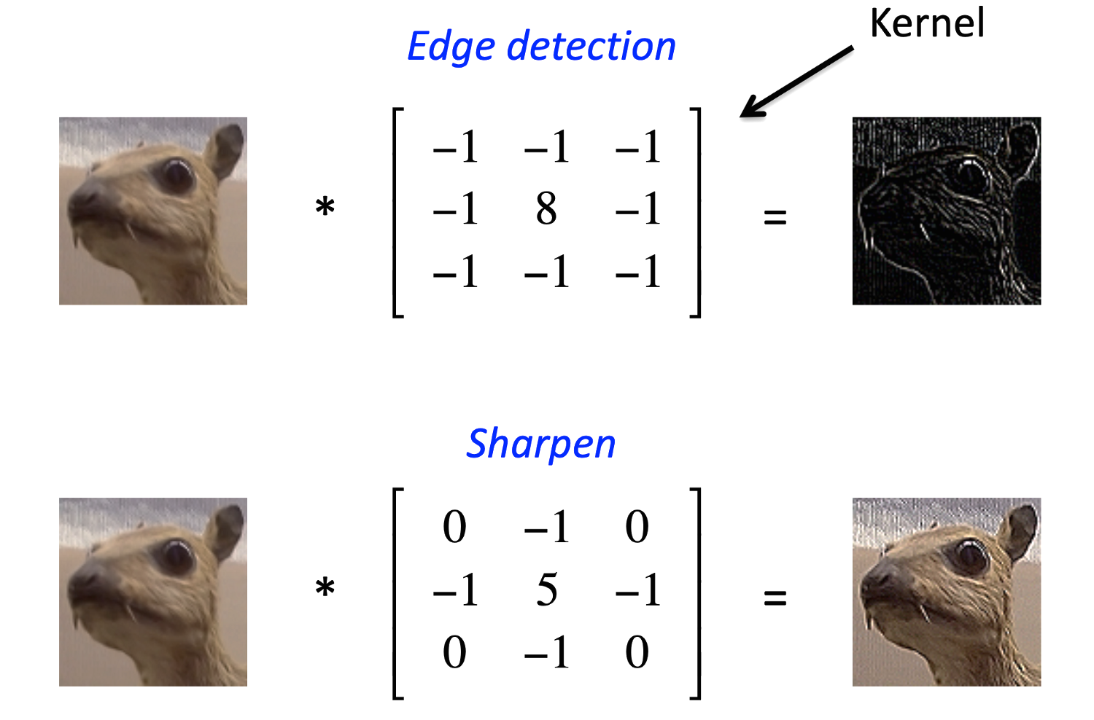
Features from kernels
Image source: towardsdatascience
Notes:
Different kernels bring out different features from the image. For example the kernels shown in the slide bring out edges and sharpness in the image respectively. You can look at the kernel and figure out what it is trying to bring out from the image. For instance in the first edge detection kernel, if all the values in the region the kernel is superimposed on are equal. The output of the weighted sum is going to be zero. Because there are 8 -1s and 1 +8 in the kernel. But if the the pixel in the centre has a high value and the surrounding pixels have a low value, then the overall result of the kernel is going to be a high value. It denotes that there is an edge present in that region. More such kernels and their results can be visualized in the tutorial notebook.

Slide 10
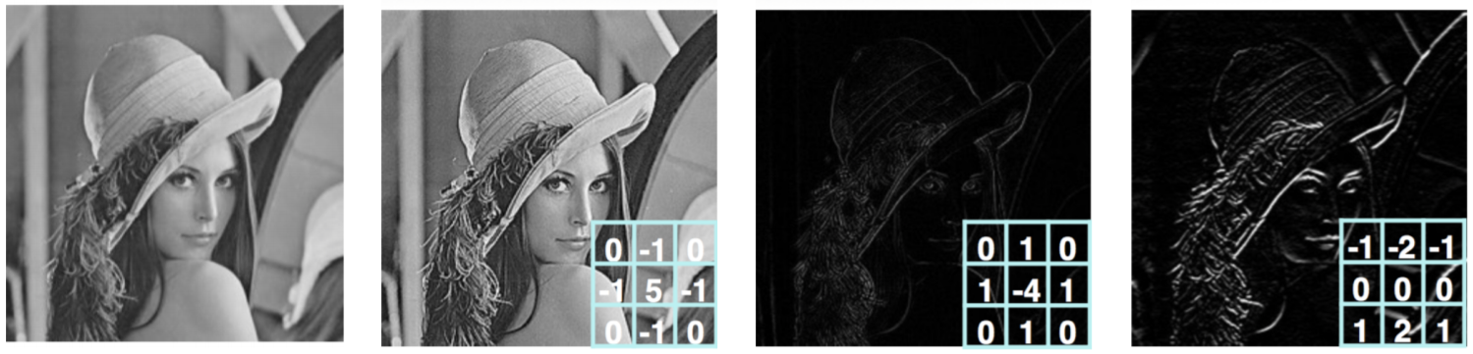
Features from kernels
Original
Sharpen
Edge Detect
Stronger Edge Detect
Notes:
Some more kernels.

Slide 11
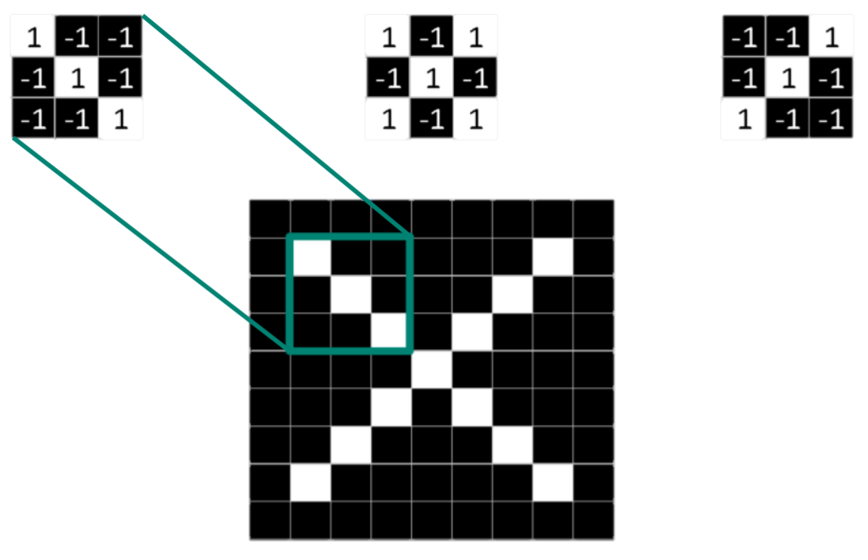
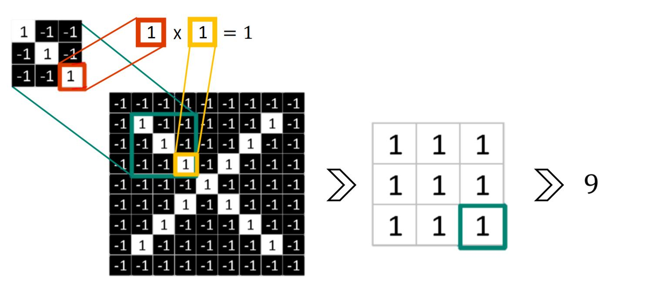
Features from kernels
Notes:
The kernels represent the kind of features they extract from the image. When going through the entire image, the windows which give the highest value show strong presence of that particular feature. With CNNs we try to learn the these different features/kernels for a particular task

Slide 12
Convolutional neural networks

Slide 13
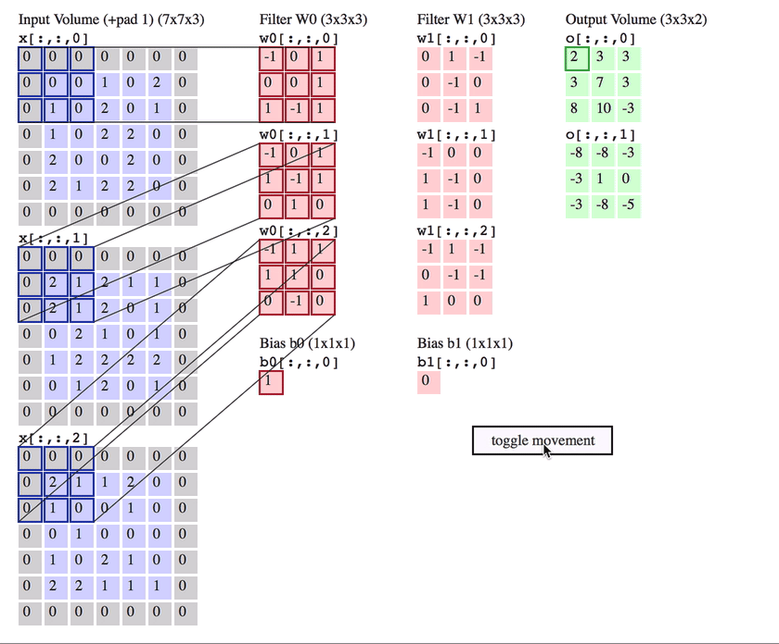
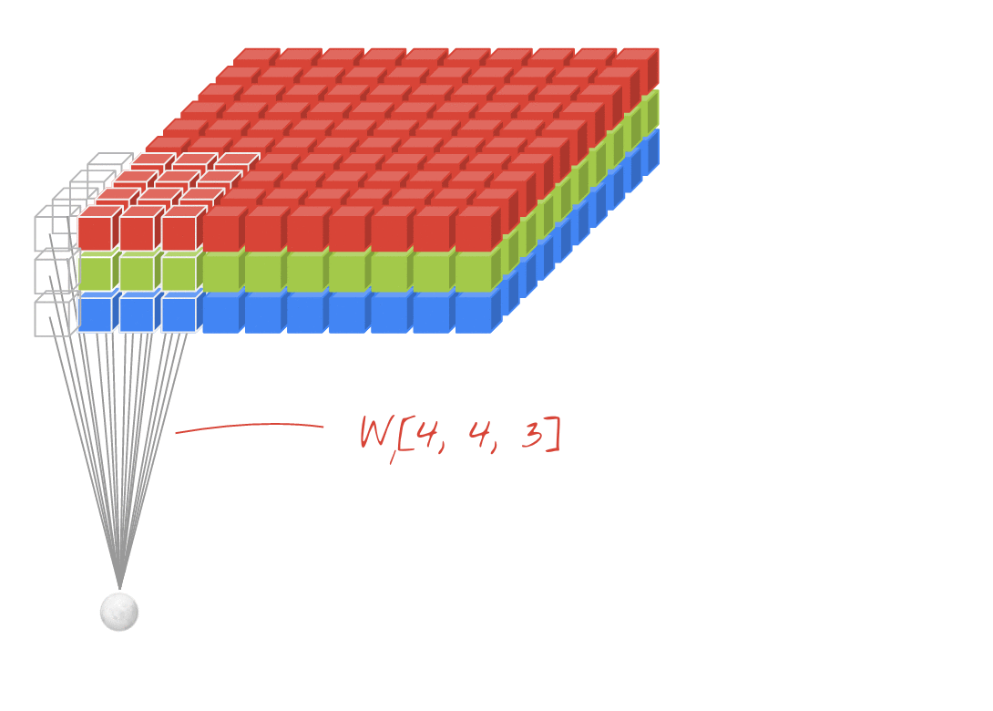

Convolutional layer
Image source: cs231 notes
Notes:
Stride is the distance in pixels the kernel moves after each iteration. The videos show the computation involved in a convolutional layer. The third dimension/depth of the kernel is equal to the third dimension/depth of the input volume in 2D convolution. The bottom right image shows the path of kernel while calculating the output.

Slide 14
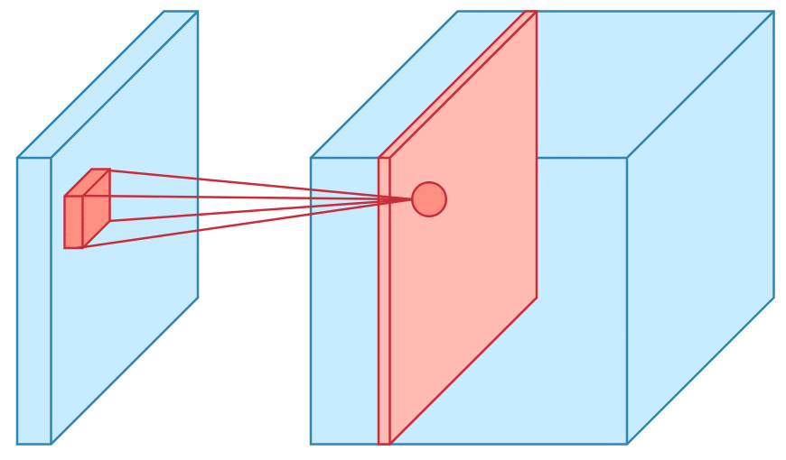
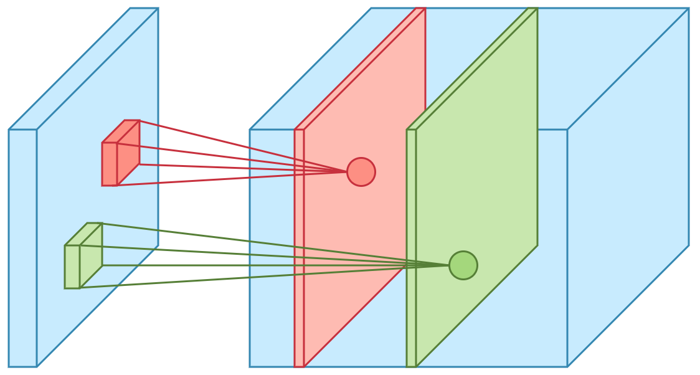
Convolutional layer
Image source: towardsdatascience
Notes:
More visualisation of the same computation. Green and red are two different filters/kernels. They form different channels in the output volume.

Slide 15
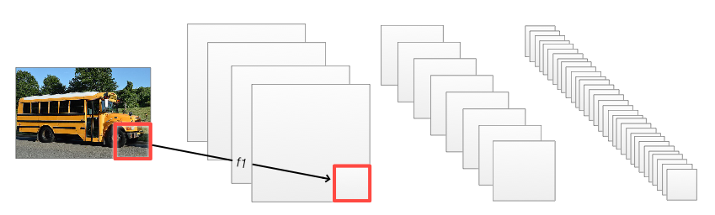
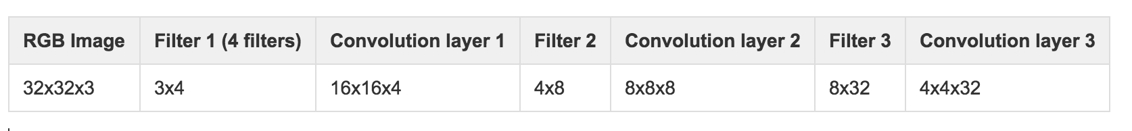
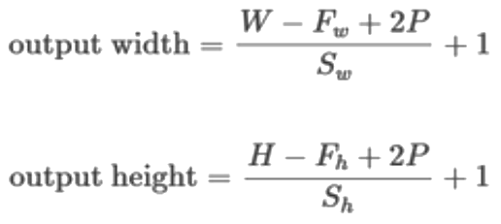
Convolutional layers
2x2x4 (s=2)
2x2x8 (s=2)
2x2x32 (s=2)
Notes:
Valid Convolution decreases the dimensions of the image by the next layer. Let the input image be of size 32X32X3. And the first convolution layer has 4 kernels of size (2,2) with stride 2. Then the next layers size is going to be 16x16x4. And so on according to the formula

Slide 16
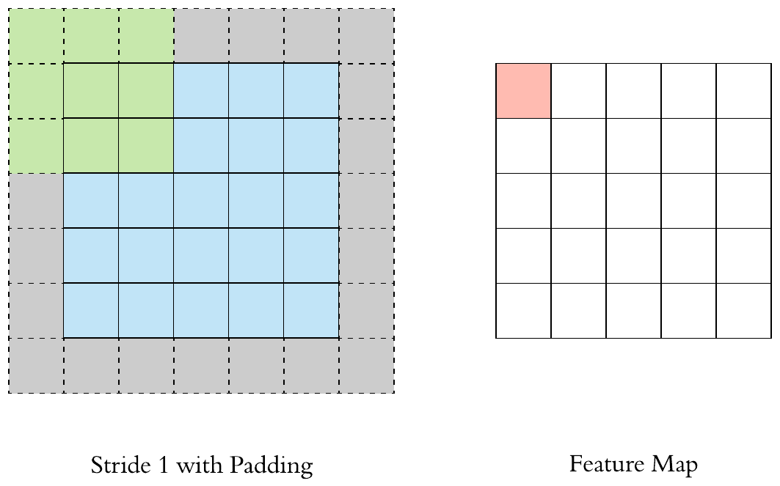
Padding
Image source: towardsdatascience
Notes:
The grey squares represent zeros added to the original image(with blue pixels). The feature map(red pixels) would be of same size as original image because of the zero padding.

Slide 17

Pooling Layers
Image source: towardsdatascience
Notes:
The image shows max pooling and average pooling applied on the same input. The max pooling of 2X2 size only brings out the maximum value in the 2X2 region and the average pooling of 2X2 size brings out the average of the values in the 2X2 region. Here the stride is 2

Slide 18
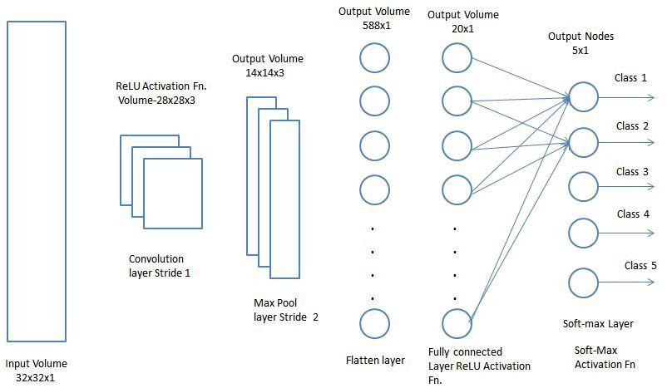
Flatten and fully connected layers
Image source: towardsdatascience
Notes:
Flattening and fully connecting all the neurons to a fully connected layer:
We flatten the final convolutional layer to fully connect with the Fully connected layers at the end. They are generally used for classification and regression tasks

Slide 19

CNNs for classification
Image source: towardsdatascience
Notes:
The image shows the generic architecture of a CNN for image classification task. It has multiple convolutional layers followed by pooling layers and some fully connected layers in the end for the final prediction. The final layer is going to be of the size of the number of classes.

Slide 20


AIML @WORK
PGPAIML @ Great Learning
Enabling Learners to Apply the AI/ML Concepts at Work
Apply AIML at your workplace to gain some instant benefits:
Get noticed by your management with your outstanding analysis backed by data science.
Create an impact in your organization by taking up small projects/initiatives to solve critical issues using data science.
Network with members from the data science vertical of your organization and seek opportunities to contribute in small projects.
Share your success stories with us and the world to position yourself as a subject matter expert in data science.
AIML Operations | AIMLAW
@Great Learning Proprietary Content. All rights reserved. Unauthorized use or distribution prohibited

Slide 21
Summary

Slide 22
In summary - Deep CNNs
Kernels are feature extractors
CNNs are trained to learn the features
Convolutional Layers
Stride and Padding
Max and Average Pooling Layers
Flattening and Fully connected final layers
CNN Classifier

Slide 23
Thank you! :)
Questions are always welcome

